Slide 1
Python Workshop - Raspberry Pi -
2017년 8월
서강대학교

Slide 2
보조 도구들
Online White Board
http://bit.ly/2017sopython1
Shared List
http://bit.ly/2017sopython2
온라인 자료
https://www.python.org/
http://byteofpython-korean.sourceforge.net/byte_of_python.html
http://pythonstudy.xyz/
https://wikidocs.net/book/1
https://opentutorials.org/course/1750
Example Programs
https://www.programiz.com/python-programming/examples

Slide 3
Working with Raspberry Pi RPi 설치하기

Slide 4
Setting Up Raspbery Pi 3
https://www.raspberrypi.org
NOOBS (New Out Of Box Software)
Download NOOBS image
Format SD Memory Card using “SD Memory Card Formatter”
Copy files (NOOBS) to SD Memory Card
Boot and go!
Raspbian
https://www.raspberrypi.org/documentation/installation/installing-images/README.md
Download raspbian image
Write image to SD card using “etcher”
For headless setup
https://core-electronics.com.au/tutorials/raspberry-pi-zerow-headless-wifi-setup.html
Steps
Using windows, change device/directory SD card device
Create “wpa_supplicant.conf” then add the lines →
Create “ssh”
Boot
Figure out IP address of your Pi
Ssh with login pi and the password raspberry
network={
ssid="SSID"
psk="password"
key_mgmt=WPA-PSK
}

Slide 5
Keep your pi up-to-date
https://www.raspberrypi.org/learning/software-guide/
sudo apt-get update
sudo apt-get upgrade
sudo apt-get install package

Slide 6
Python Versions
Python 2 vs Python 3
https://www.raspberrypi.org/documentation/usage/python/more.md
print “abc” vs print(“abc”)
Reserved words
https://docs.python.org/3.3/reference/lexical_analysis.html#keywords
https://docs.python.org/2/reference/lexical_analysis.html#keywords
PEP 8
http://legacy.python.org/dev/peps/pep-0008/
Running Python
REPL (Read-Eval-Print-Loop), Interactive top level, Language Shell -- Wikipedia
$ python3
Ipython
$ sudo apt-get install ipython3
$ ipython3

Slide 7
Installing Python Libraries
https://www.raspberrypi.org/documentation/linux/software/python.md
APT (Advanced Package Tool)
To install package from the Python Package Index (PyPI)
$ sudo apt-get update
$ sudo apt-get upgrade
PIP
$ sudo apt-get install python3-pip

Slide 8
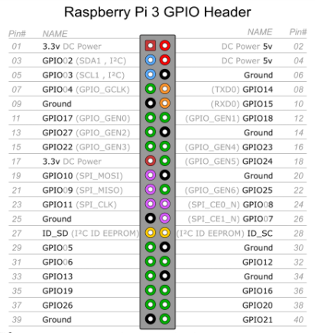
GPIO
https://www.raspberrypi.org/documentation/usage/python/more.md
$ sudo apt-get install python3-rpi.gpio
import RPi.GPIO as GPIO
import time
GPIO.setmode(GPIO.BOARD) # set board mode to Broadcom
GPIO.setup(3, GPIO.OUT)
GPIO.setup(5, GPIO.OUT)
GPIO.setup(7, GPIO.OUT)
for i in range(0,30):
print(i)
GPIO.output(3, i&0x4)
GPIO.output(5, i&0x2)
GPIO.output(7, i&0x1)
i += 1
time.sleep(0.5)
GPIO.cleanup()

Slide 9
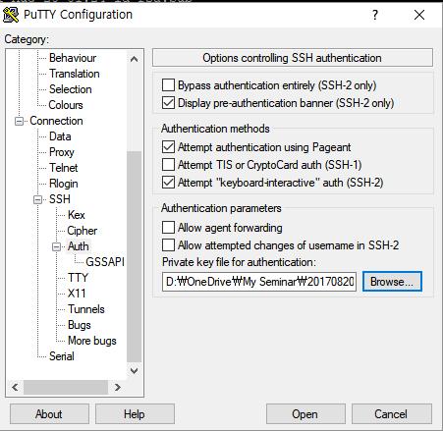

RPi Configuration
sudo raspi-config
Do some settings
Remote desktop
VNC
http://www.realvnc.com
Setup SSH Keys
https://dvpizone.wordpress.com/2014/03/02/how-to-connect-to-your-raspberry-pi-using-ssh-key-pairs/
SSH-2 RSA 2048
Public Key → ~/.ssh/authorized_keys
Public Key → Putty configuration

Slide 10
Python Language

Slide 11
Python and C
https://blog.udemy.com/python-vs-c/
The syntax emphasizes code readability by allowing programmers to use 10% of the code required by other languages, such as C.
Python is often used as a scripting language, but is also extremely effective as a standalone program.

Slide 12
print function
print(“hello world”)
Print(“hello”, “world”)

Slide 13
Variables
Basic unit of storing data in a computer program
counter = 5
length = height = breadth = 2
x, y = 2, 3
Type function
print(type(counter))

Slide 14
Dynamically Typed
key = 6
print(key)
key = “kim”
print(key)

Slide 15
Strongly Typed
key = 6
print(key)
name = “kim” + key
print(name)

Slide 16
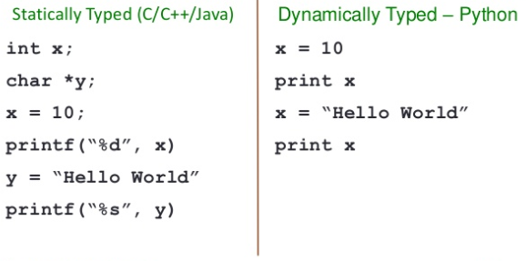
Data Types
Standard Data Types
Number
String
List
Tuple
Dictionary

Slide 17
Python의 사칙연산
Among
Int, float, string,

Slide 18
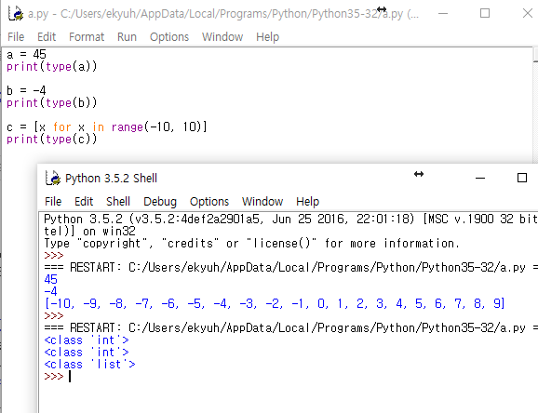
Integer (정수)
정수의 정의
http://terms.naver.com/entry.nhn?docId=333...
정수의 연산
덧셈, 뺄셈, 곱셈
Python에서 일정 범위
집합의 정의
Python에서 정수인지 확인
print( type(a))

Slide 19
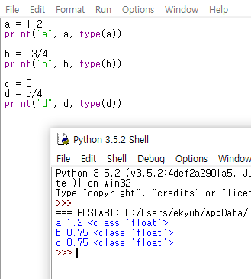
floating point (소수)
소수
http://terms.naver.com/entry.nhn?docId=95...
https://en.wikipedia.org/wiki/Floating_point
The term floating point refers to the fact
that a number's radix point can "float“.
Python에서 소수의 표현
a = 1.2
b = 3/4

Slide 20
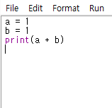
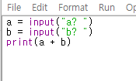
Break Time
Non sense quiz
1 + 1 = ?
맥락에 대한 이해가 필요

Slide 21
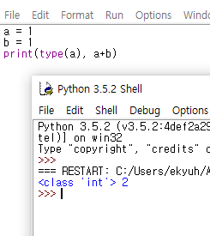
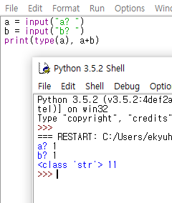
Break Time
Non sense quiz
1 + 1 = ?
Input( )은 항상 string을 준다!

Slide 22
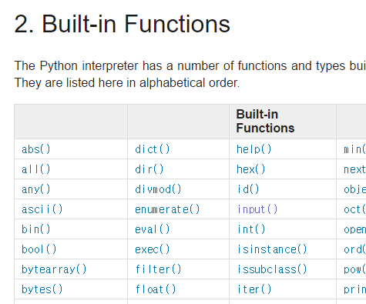
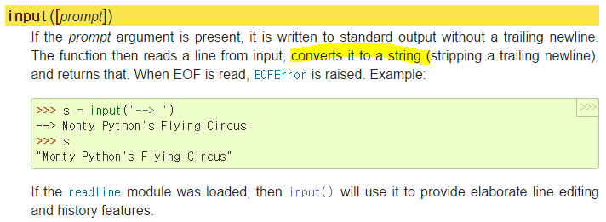
always try internet search !!!

Slide 23
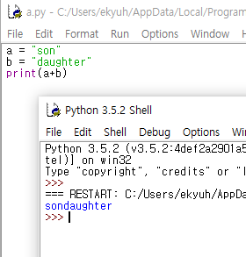
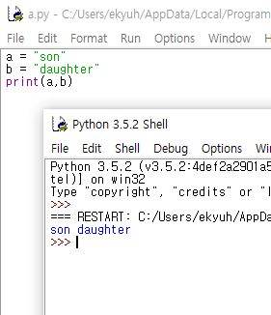
String (문자)
print 문에 “,”를 사용해서 여러 개를 프린트하면 한칸씩 자동으로 떼어짐

Slide 24
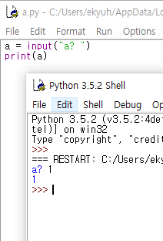
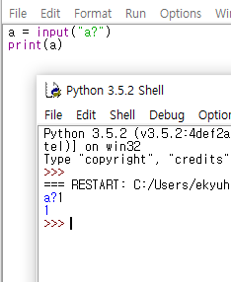
String (계속)
“ “도 string!

Slide 25
서로 다른 데이터 타입 간의 혼합
Int, Float, Str간의 사칙연산
Data type | 연산자 | Data type
Int | + - * | Int | Int
Int | / | Int | Float
Float | + - * / | Int | Float
Str | + | Str | → Str
Str | + - * / | Int, Float | → Error

Slide 26
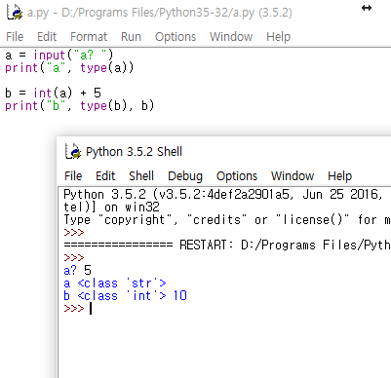
서로 다른 타입 간의 혼합 (계속)
Str 타입을 강제로 변환 시켜 주어야 함
int(str)
float(str)
Why?

Slide 27
Control Structure
Conditionals
if a<b:
print(“ok”)
else:
print(“not ok”)
Loops
a, b = 0, 5
while a<b:
print(a)
a += 1
for i in range(10):
print(i)

Slide 28
Indentation
lastname = input('Lastname? ')
point = input('Point? ')
if lastname in { 'kim', 'lee' }:
point = int(point) + 20
print(point)
else:
point = int(point) + 10
print(point)
input('anything else? ')

Slide 29
Github on RPi

Slide 30
Install git
$ git init
$ git status
$ git add *.py
edit any file
$ git status
$ git commit -m "my file“
$ git config --global user.email “ekyuho@gmail.com“
$ git config --global user.name “Kyuho Kim“
$ git add t3.py
$ git checkout –b test1
$ git status
edit something
$ git add *
$ git commit –m “hot fix”
$ git checkout master
$ git status
$ git merge test1
$ git status
On RPi
sudo apt-get install git
Follow beginner’s guide
https://guides.github.com/activities/hello-world/
Branch and merging
https://git-scm.com/book/en/v2/Git-Branching-Basic-Branching-and-Merging

Slide 31

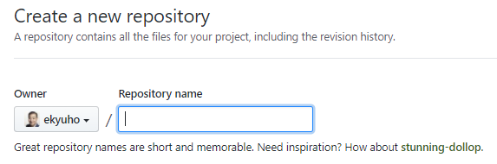
Work as a team
http://github.com
create account
create a project
link my local repository and remote
git remote add origin https://github.com/ekyuho/pythonworkshop0821.git
git push -u origin master

Slide 32
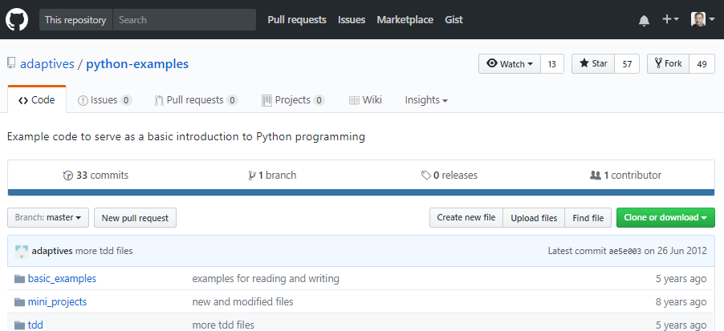
Fork Python Examples
https://github.com/adaptives/python-examples

Slide 33
Remote Branching
$ git clone https://github.com/ekyuho/python-examples.git
do some editing
$ git push origin master
check your modification on
https://github.com/ekyuho/python-examples/tree/master/basic_examples

Slide 34
Programming Projects
파일에서 숫자를 읽어들인다
숫자의 개수, 합을 계산한다.
Sequence가 빠진 것들을 찾아내어 출력한다.(1,2,3,5,6) 이라면 4가 빠진것이다.
파일에서 한 라인씩 읽어들인다.
각 라인에서 숫자와 숫자가 아닌 글자를 구분하여 2 칼람으로 출력한다.
숫자 맞추기 게임을 한다.
답이 현재 숫자보나 높으면 하얀색LED를, 아래쪽이면 LED를 끄고, 컴퓨터가 이기면 파란색 LED를, 사람플레이어가 이기면 빨간색 LED를 킨다.
Your Idea?

